Slide 1
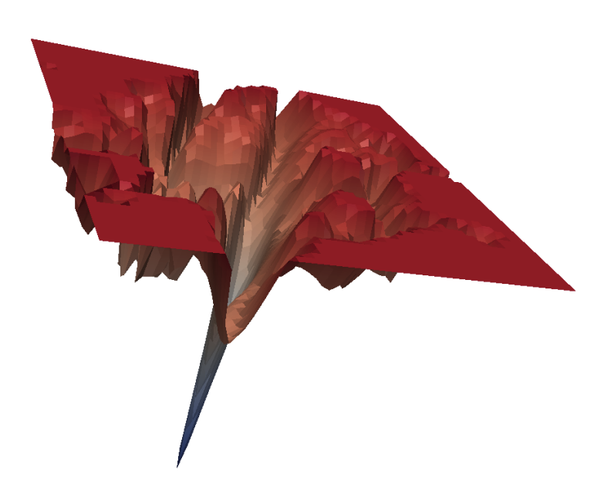
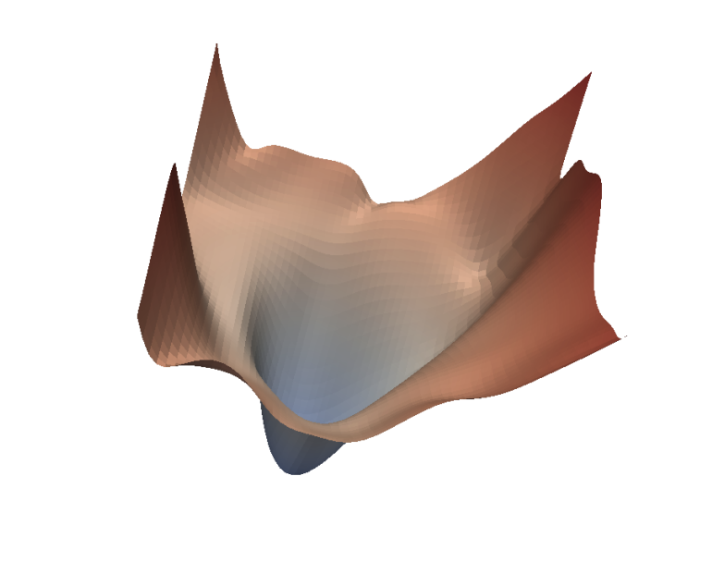


A Modern Look at the Relationship between Sharpness and Generalization (ICML 2023)
Maksym Andriushchenko (EPFL), Francesco Croce (U of Tübingen), Maximilian Müller (U of Tübingen), Matthias Hein (U of Tübingen), Nicolas Flammarion (EPFL)
Main question: Can sharpness of minima explain generalization in modern practical settings?
sharp minimum
flat minimum
21 July 2023, Tatsu’s lab

Slide 2
Big picture: understanding the generalization puzzle in overparametrized deep learning
Underparametrized DL: training loss / perplexity already correlates very well with generalization! In most cases: we just need to minimize the training loss
Overparametrized DL: different global minima can generalize very differently e.g., see “Bad Global Minima Exist and SGD Can Reach Them” (Liu et al. NeurIPS’19)
What measure computed on the training set can distinguish the minima which generalize well?
Can we figure this measure and optimize it for training? (+ use it as a tool to understand the generalization puzzle)

Slide 3
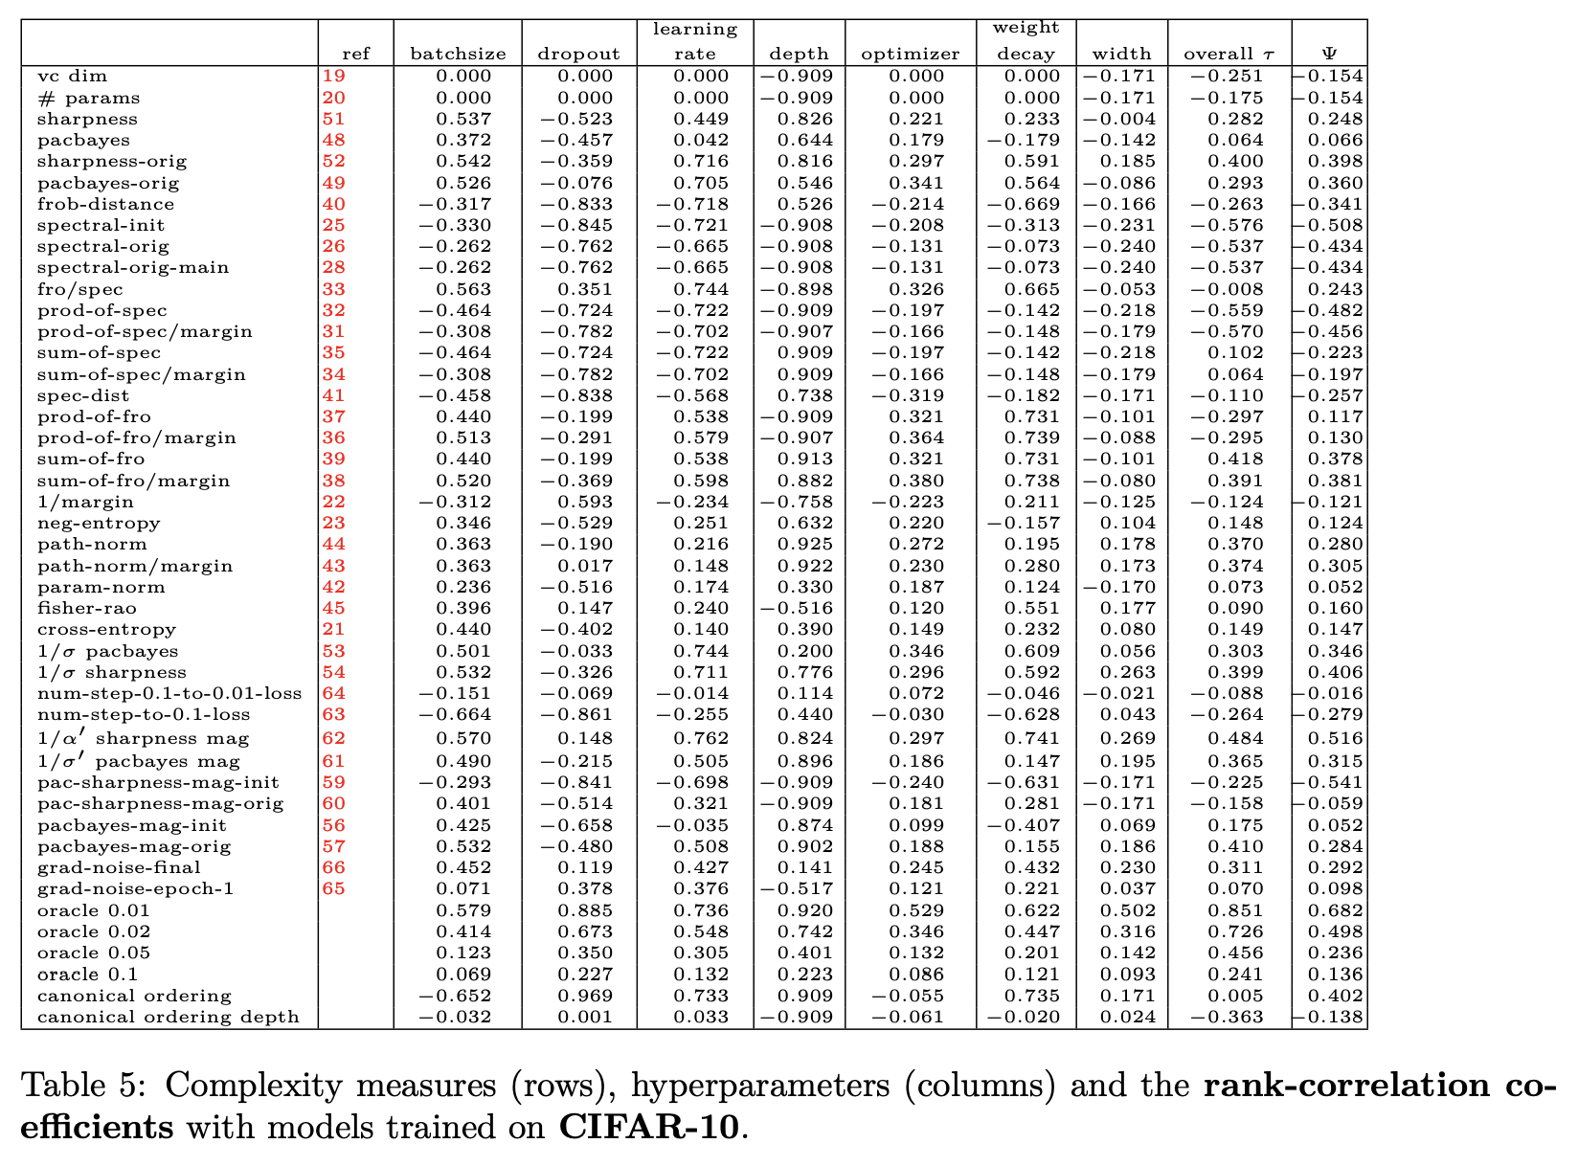
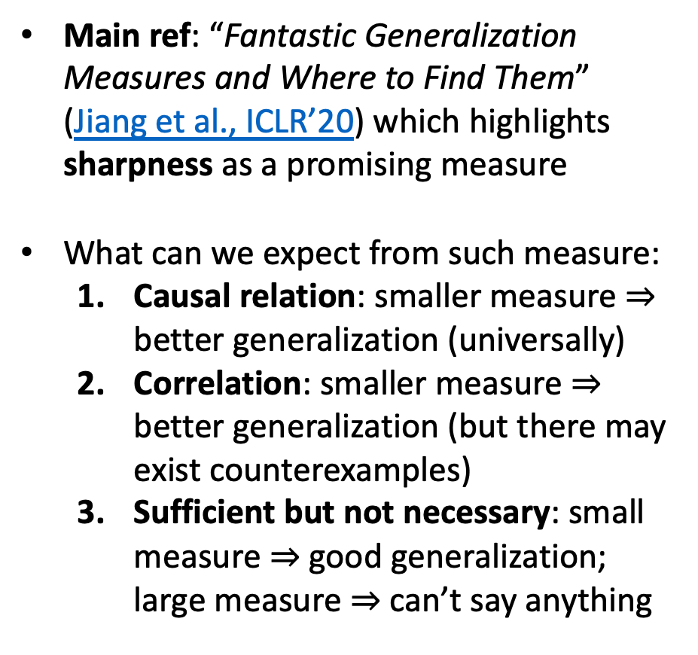
Prior work: finding such measures is actually not easy!
Main ref: “Fantastic Generalization Measures and Where to Find Them” (Jiang et al., ICLR’20) which highlights sharpness as a promising measure
What can we expect from such measure:
Causal relation: smaller measure $⇒$ better generalization (universally)
Correlation: smaller measure $⇒$ better generalization (but there may exist counterexamples)
Sufficient but not necessary: small measure $⇒$ good generalization; large measure $⇒$ can’t say anything
Notes:
Many papers assume causal relation!

Slide 4
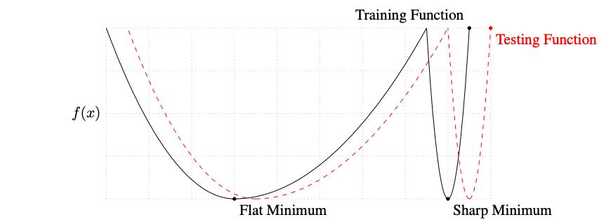
Flat vs. sharp minima: intuition
Popular intuition: the test loss should be close to the training loss for a flat minimum
can be under
a distribution shift
Source: “On Large-Batch Training for Deep Learning: Generalization Gap and Sharp Minima” (Keskar et al., ICLR’17)
Renewed interest due to works on explicit (Sharpness-Aware Minimization, ICLR 2021) and implicit sharpness minimization (Edge of Stability regime of GD, ICLR 2021)

Slide 5
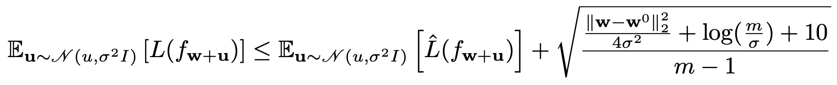
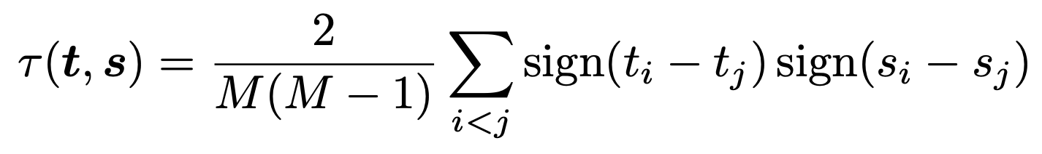
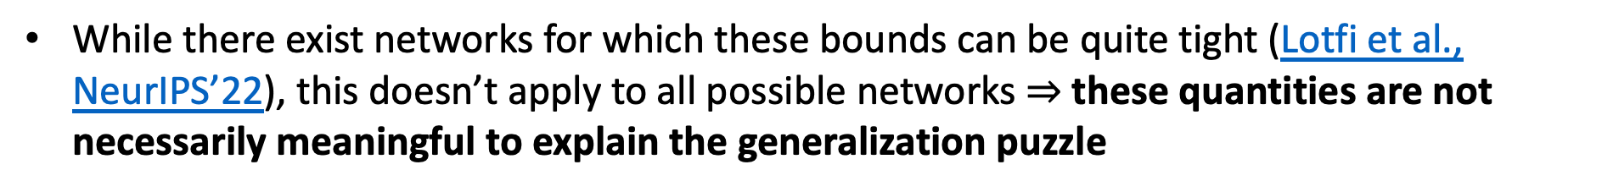
Flat vs. sharp minima: theory
There are generalization bounds based on sharpness
perturbed population loss
perturbed training loss
term that depends on the scale of the predictor
But they can be often of limited use as illustrated well by Jiang et al., ICLR’20
τ = rank correlation coefficient:
While there exist networks for which these bounds can be quite tight (Lotfi et al., NeurIPS’22), this doesn’t apply to all possible networks $⇒$these quantities are not necessarily meaningful to explain the generalization puzzle

Slide 6
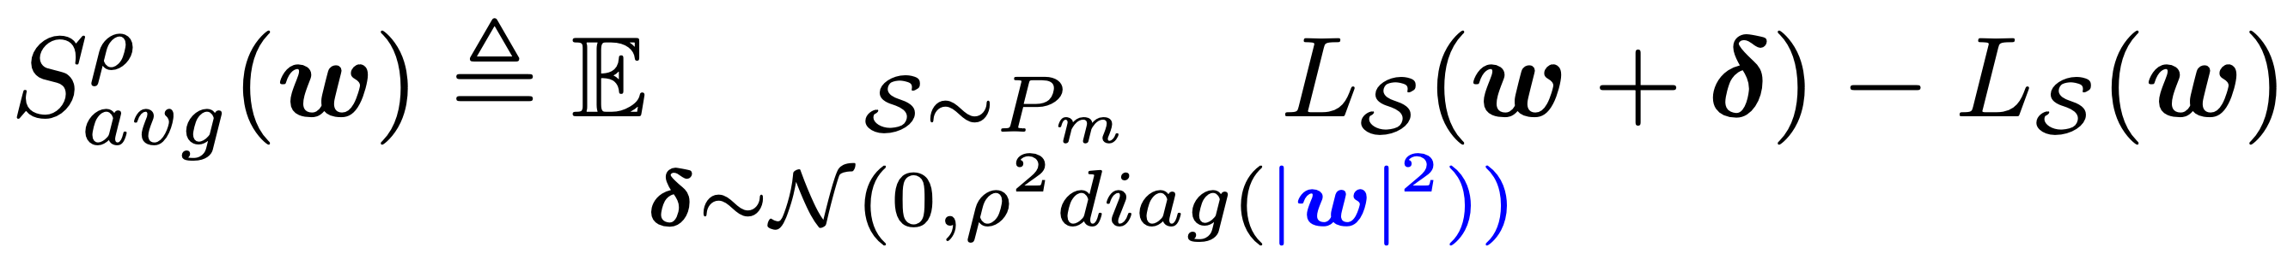
Contribution of our work
fixes apparent problems with the standard sharpness definitions
The specific question we want to answer: can adaptive sharpness explain generalization in modern practical settings?
Average-case adaptive sharpness:
Worst-case adaptive sharpness:
What we mean by modern practical settings:
datasets beyond toyish CIFAR-10 / SVHN,
vision transformers,
fine-tuning (totally underexplored),
out-of-distribution generalization.
We want to have a definite answer about whether sharpness is the right quantity!
Notes:
Adaptive sharpness: note that avg-case rho -> 0 sharpness resembles a lot relative sharpness (same core idea => many proposals in the literature)

Slide 7
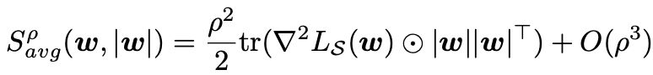
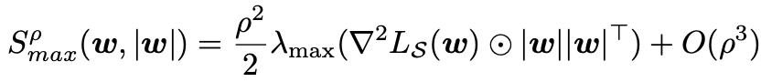
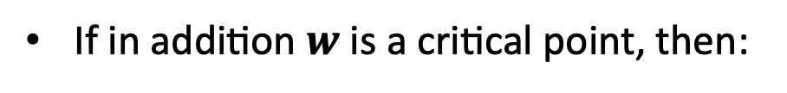
Short note 1: familiar particular cases of adaptive sharpness
When the radius at which we measure sharpness $ρ→0$, adaptive sharpness becomes
If in addition $w$ is a critical point, then:
Thus, we recover familiar and well-studied quantities based on the Hessian (if we ignore the $\left|w\right|{\left|w\right|}^{⊤}$ term)
Notes:
Adaptive sharpness: note that avg-case rho -> 0 sharpness resembles a lot relative sharpness (same core idea => many proposals in the literature)

Slide 8
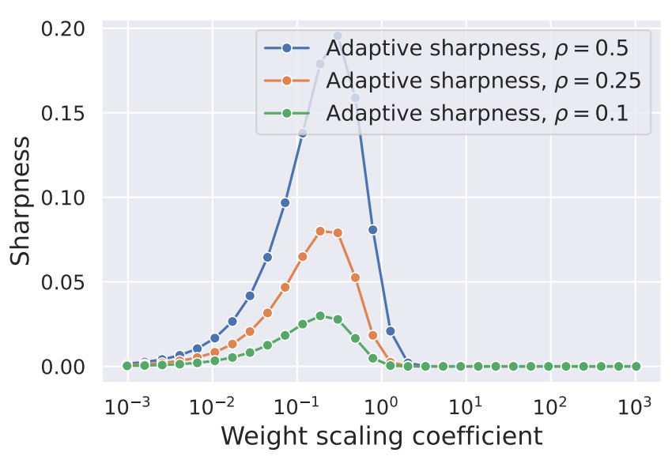
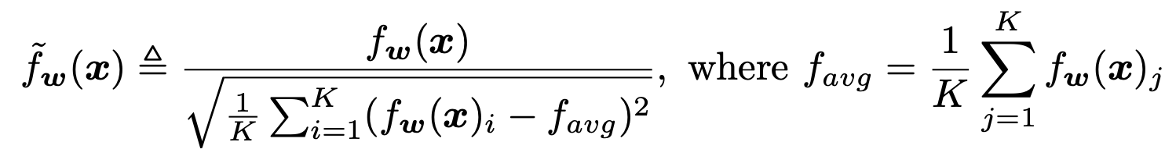
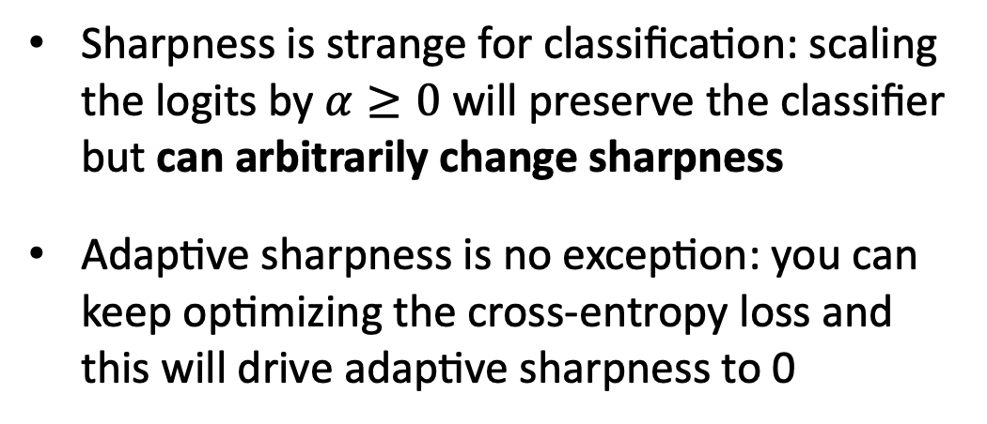
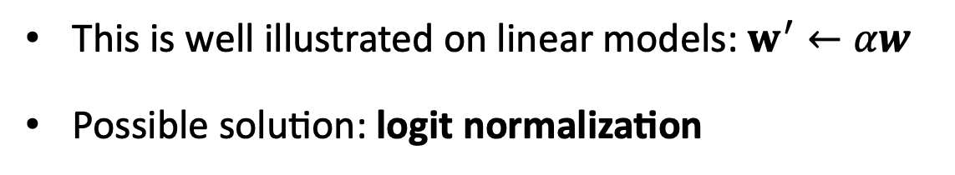
Short note 2: sensitivity to the scale of the classifier
Sharpness is strange for classification: scaling the logits by $α≥0$ will preserve the classifier but can arbitrarily change sharpness
Adaptive sharpness is no exception: you can keep optimizing the cross-entropy loss and this will drive adaptive sharpness to 0
Linear model that achieves 100% train accuracy
This is well illustrated on linear models: $w^{′}←αw$
Possible solution: logit normalization
We will benchmark all sharpness definitions with and without logit normalization

Slide 9
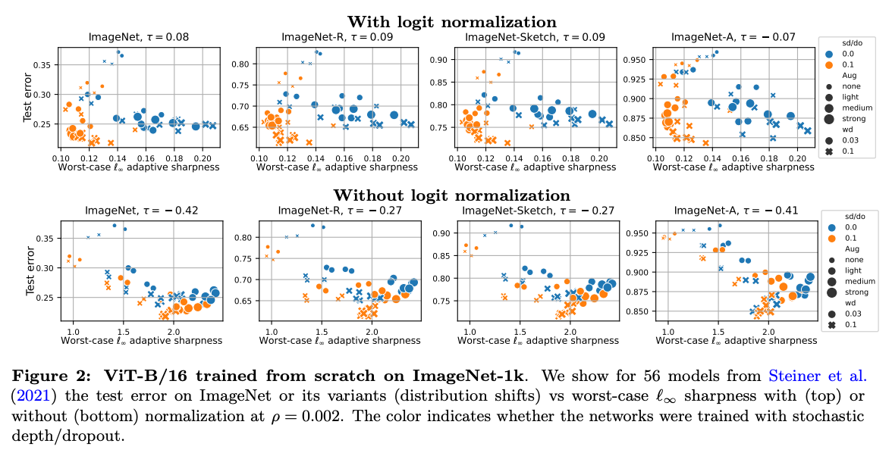
Setting #1: ViTs trained from scratch on ImageNet
The correlation (τ) is either close to 0 or even slightly negative (-0.42 on ImageNet for adaptive sharpness without logit normalization)!

Slide 10
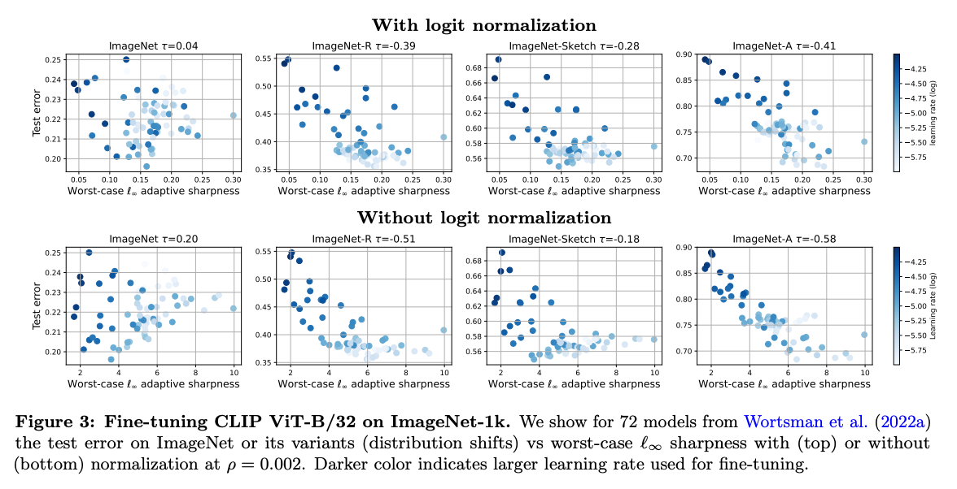
Setting #2: ViTs fine-tuned from CLIP on ImageNet
The correlation is again either close to 0 or negative, especially on distribution shifts like ImageNet-R and ImageNet-A (as low as -0.51 and -0.58!)

Slide 11
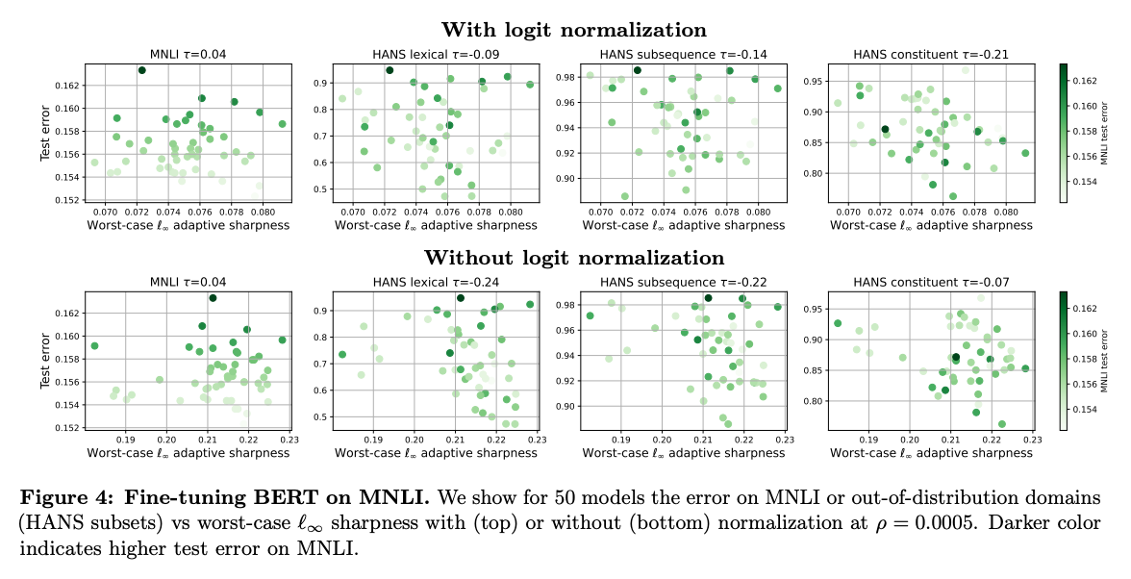
Setting #3: BERT models fine-tuned on MNLI
This case is famous since OOD generalization (see HANS lexical) can be very different
However, sharpness is not helpful to distinguish which solutions will generalize better for OOD

Slide 12
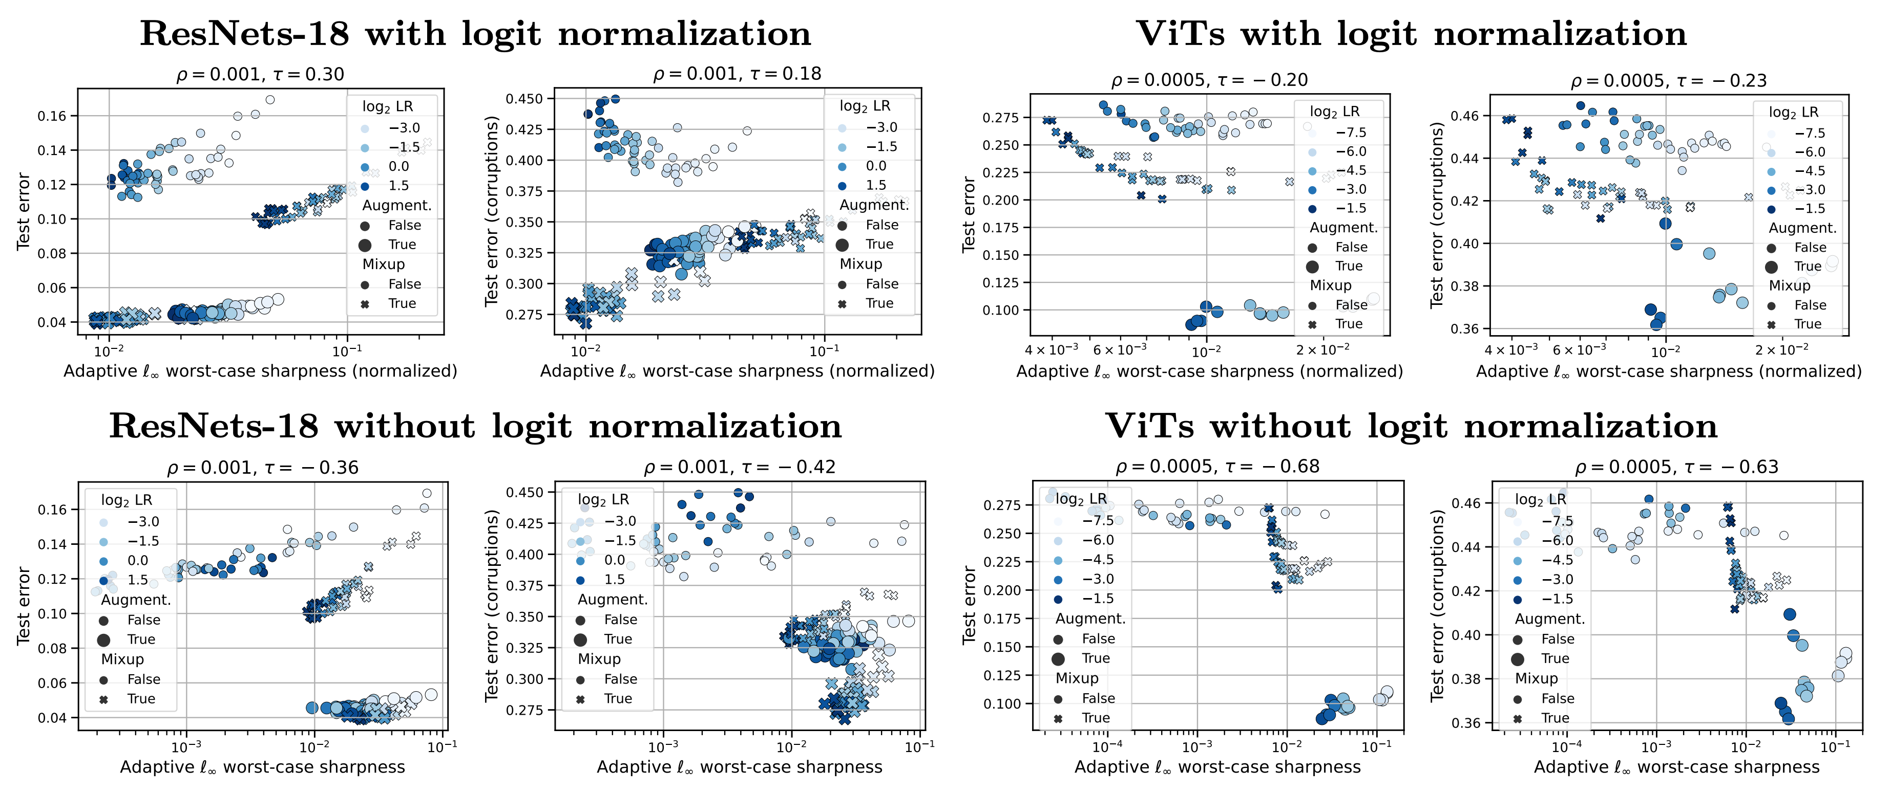
Setting #4: ResNets and ViTs trained from scratch on CIFAR-10
Maybe sharpness has to be measured close to a min? here we select only models w/ ≤1% train error
Positive correlation is present but only within subgroups of models trained with the same augmentations
Globally, however, correlation is either close to 0 or negative (as much as -0.68!)

Slide 13
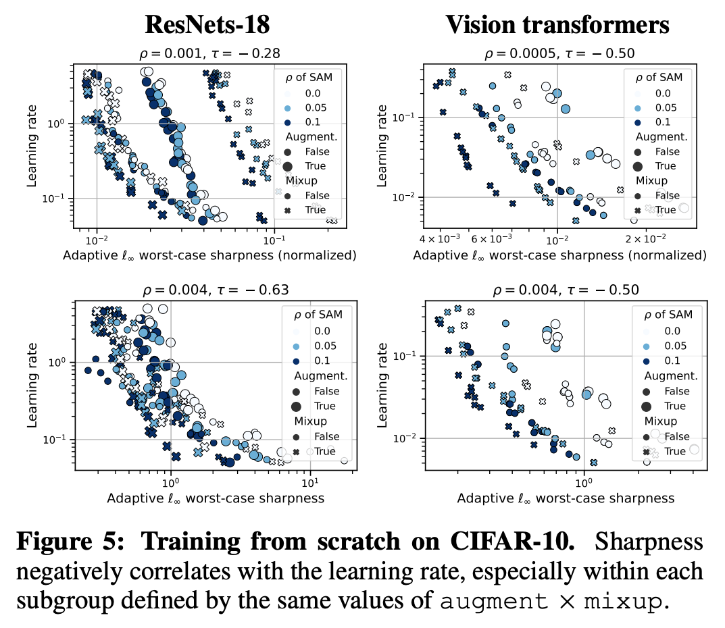
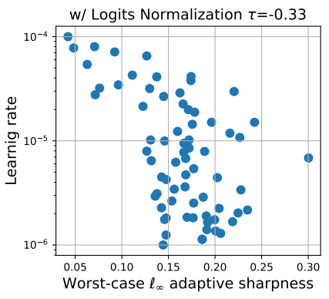
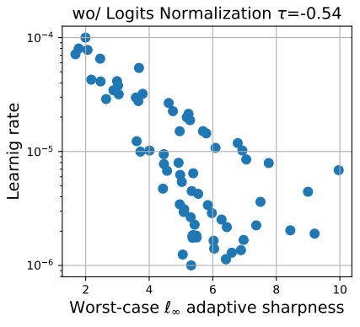
So what does sharpness really capture?
Overall, we observe that sharpness doesn't correlate well with generalization but rather with some training parameters like the learning rate
Training ResNet from scratch
Finetuning ViT on ImageNet
(with logit normalization)
(without logit normalization)
(with logit normalization)
(without logit normalization)
However, the learning rate can positively or negatively correlate with generalization depending on the setup
Roughly speaking: large LRs are good for pretraining (at least for CNNs), small LRs are good for fine-tuning. But sharpness doesn’t capture that!

Slide 14
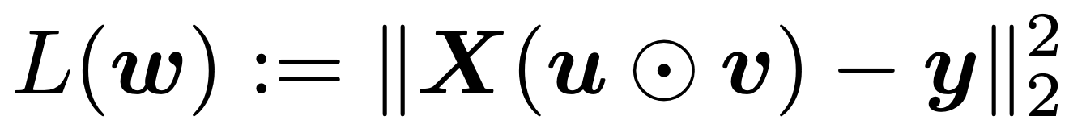
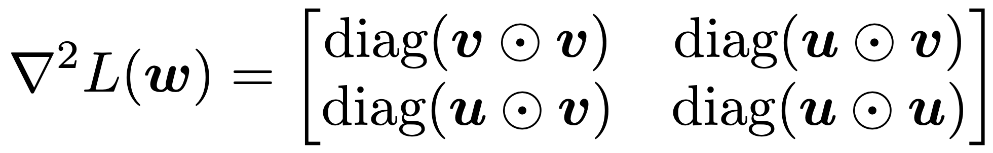
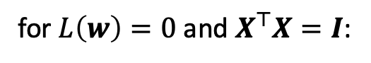
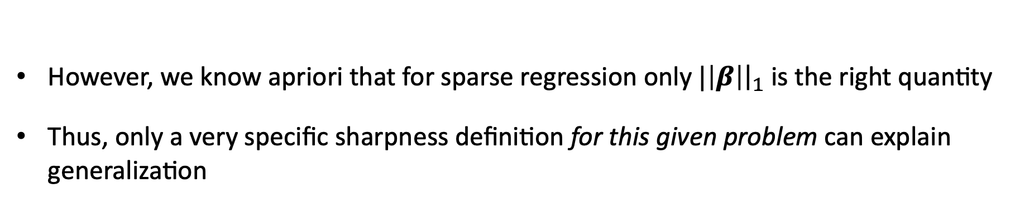
Is sharpness the right quantity in the first place? Theoretical insights
Simple model: sparse regression with a diagonal linear network $β≔u⊙v$
for $L\left(w\right)=0$and $X^{⊤}X=I$:
For appropriate adaptive sharpness with $c_{i}=\sqrt{\left|v_{i}\right|/|u_{i}|}$ for $1≤i≤d$ and $c_{i}=\sqrt{\left|u_{i}\right|/|v_{i}|}$ for $d+1≤i≤2d$
we get for $ρ→0$ that different sharpness definitions capture totally different quantities:
However, we know apriori that for sparse regression only $|\left|β\right|{\left.​\right|}_{1}$ is the right quantity
Thus, only a very specific sharpness definition for this given problem can explain generalization

Slide 15
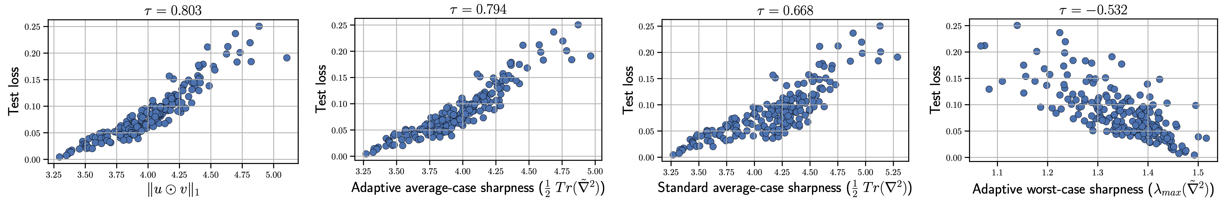
What can go wrong with the sharpness definition?
Empirical validation: a bunch of diagonal linear nets trained with different LR and init
Our analysis suggests that sharpness can be the right quantity
However, choosing the right definition of sharpness requires a precise understanding of the data and how it interacts with the architecture
This is obviously challenging beyond toy models!

Slide 16
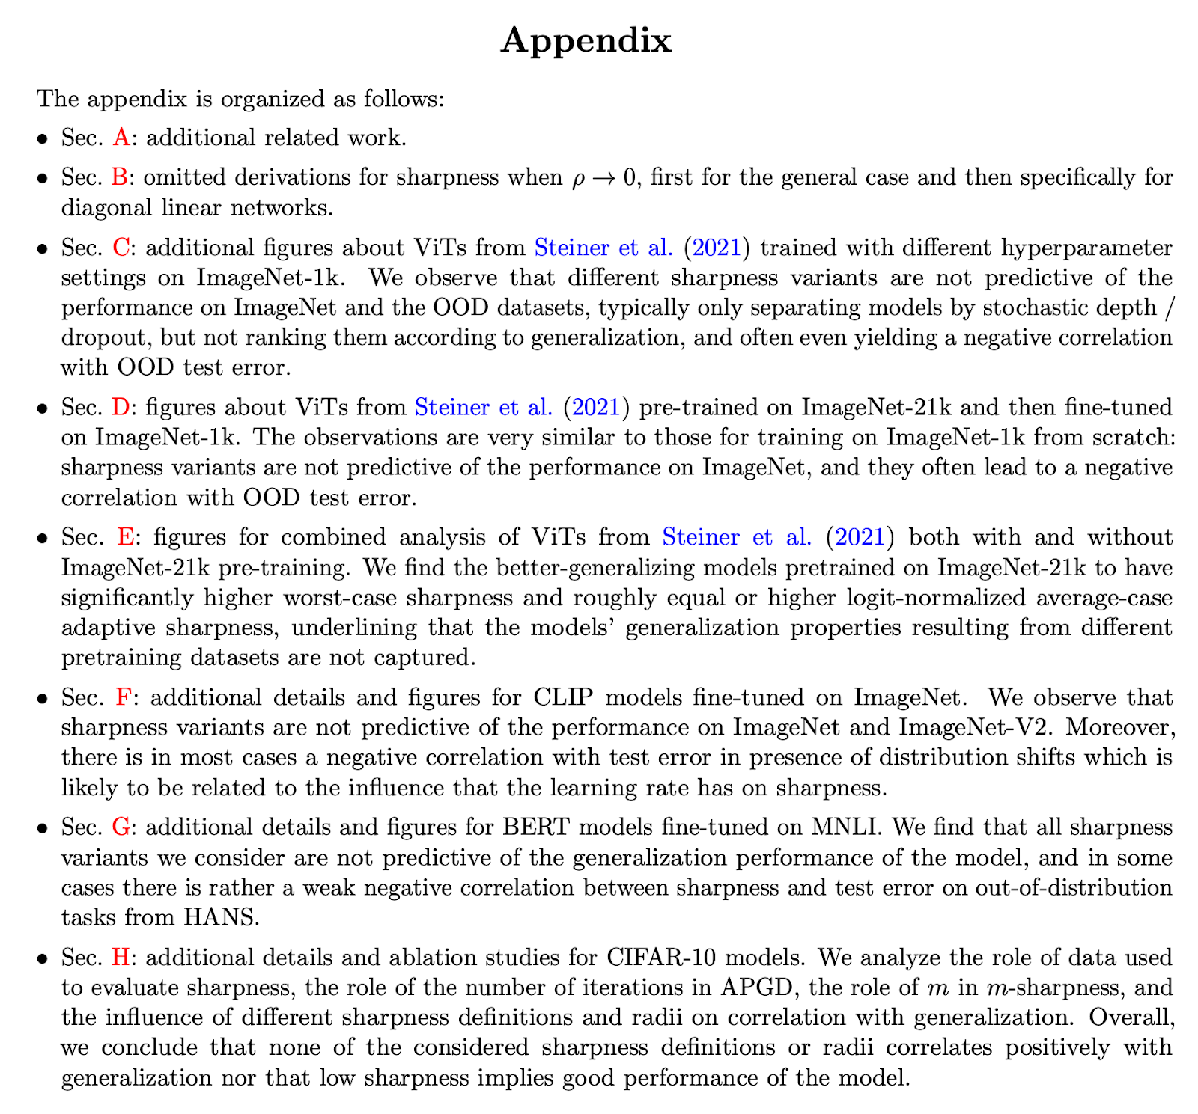
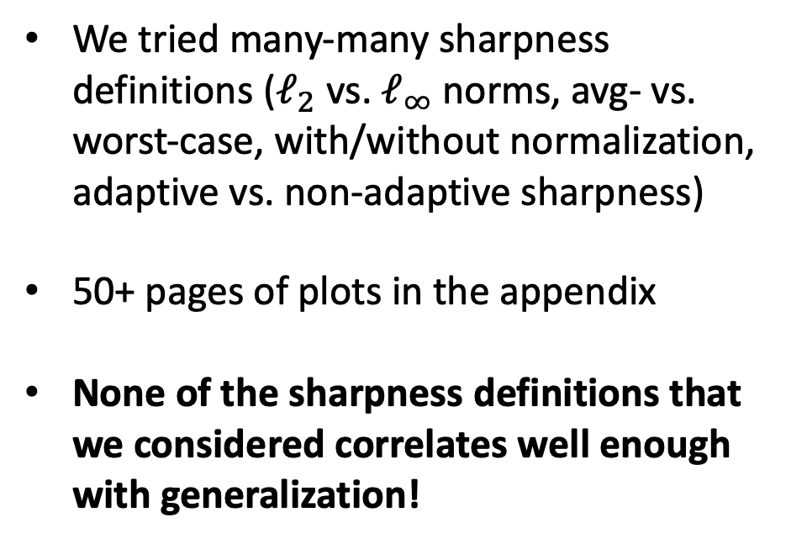
Lots of additional experiments in the appendix
We tried many-many sharpness definitions ($ℓ_{2}$ vs. $ℓ_{∞}$ norms, avg- vs. worst-case, with/without normalization, adaptive vs. non-adaptive sharpness)
50+ pages of plots in the appendix
None of the sharpness definitions that we considered correlates well enough with generalization!

Slide 17
Outlook
Is it even possible to have a single measure that would be causally related to generalization?
I think it’s highly unlikely and too good to be true (as the DLN example illustrates: this depends a lot on the data distribution)
But: there are some creative proposals like SGD-based disagreement on unlabeled data which correlates well with generalization (Assessing Generalization of SGD via Disagreement, ICLR’22)
However, for this, we need at least a small amount of unseen unlabeled data… then why not assuming that we have a small amount of unseen labeled data?
Regarding the success of sharpness-aware minimization: it can be useful to get a locally flatter solution but at the same time there may exist another solution with much better generalization but the same flatness.
Thanks for your attention! Happy to discuss more :)

Slide 18
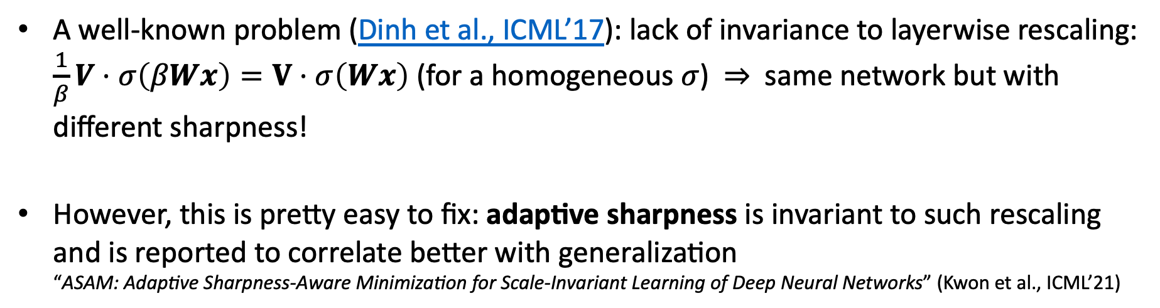
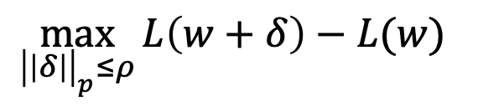
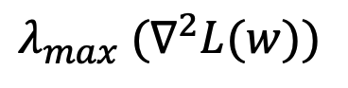
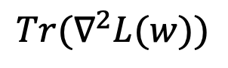
Problems with the standard sharpness definitions
$$\max_{{\left|\left|δ\right|\right|}_{p}≤ρ}{L\left(w+δ\right)−L(w) }$$
$$Tr(∇^{2}L(w))$$
$$λ_{max} (∇^{2}L(w))$$
Keskar et al., ICLR’17 + many other papers
Keskar et al., ICLR’17, Damian et al., NeurIPS’21 + many other papers
Keskar et al., ICLR’17, + many other papers
A well-known problem (Dinh et al., ICML’17): lack of invariance to layerwise rescaling: $\frac{1}{β}V⋅σ\left(βWx\right)=V⋅σ\left(Wx\right)$ (for a homogeneous $σ$) $⇒$ same network but with different sharpness!
However, this is pretty easy to fix: adaptive sharpness is invariant to such rescaling and is reported to correlate better with generalization “ASAM: Adaptive Sharpness-Aware Minimization for Scale-Invariant Learning of Deep Neural Networks” (Kwon et al., ICML’21)

Slide 19
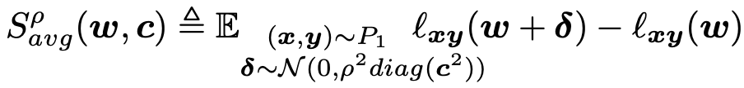
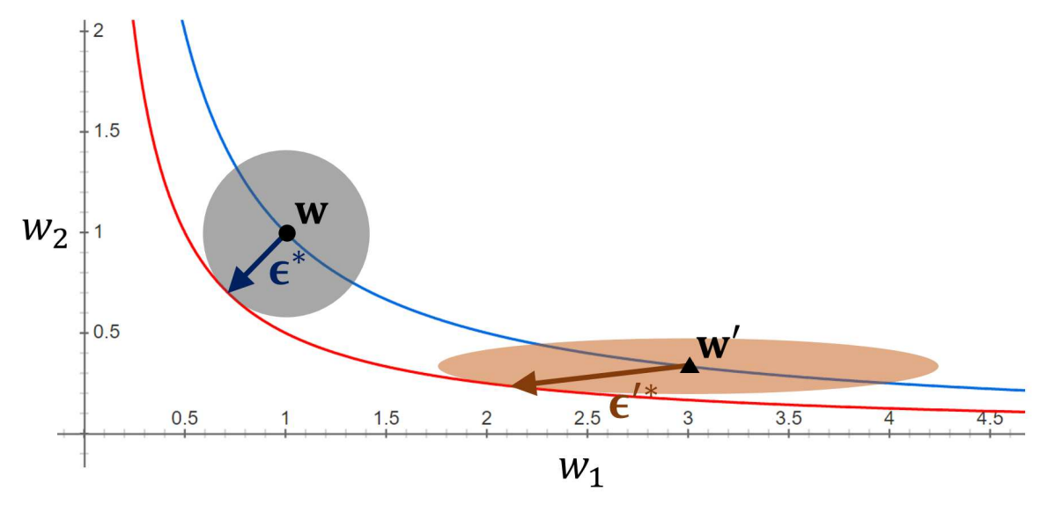
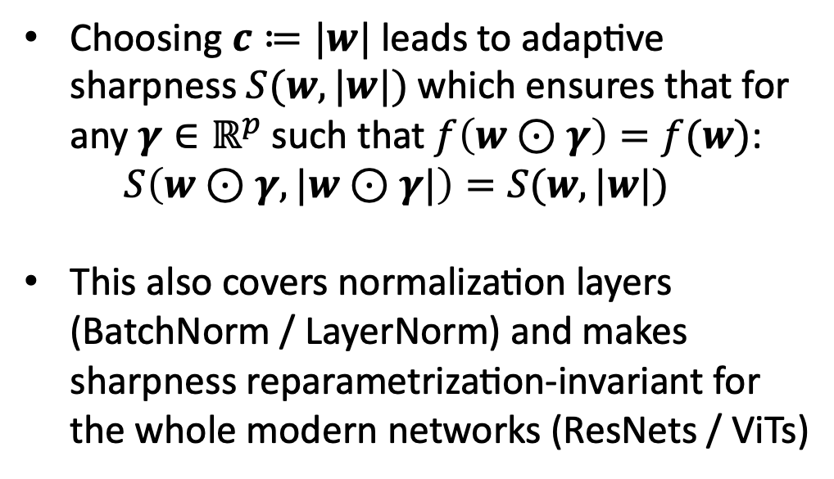
Adaptive sharpness: definition
Average-case sharpness:
Worst-case sharpness:
Choosing $c≔|w|$ leads to adaptive sharpness $S(w, |w|)$which ensures that for any $γ∈ℝ^{p}$ such that $f\left(w⊙γ\right)=f(w)$: $S\left(w⊙γ, |w⊙γ|\right)=S(w, |w|)$
This also covers normalization layers (BatchNorm / LayerNorm) and makes sharpness reparametrization-invariant for the whole modern networks (ResNets / ViTs)
Source: Kwon et al., ICML’21
for a proof: see our paper or Kwon et al.

Slide 20
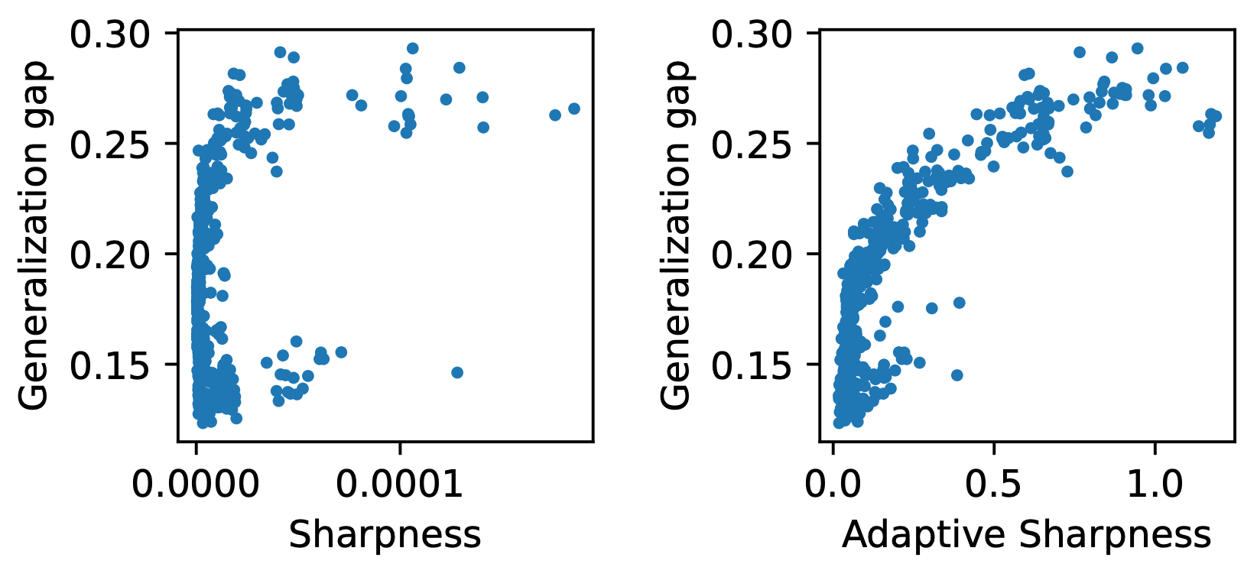
Adaptive sharpness: better correlation with generalization
Adaptive sharpness is reported to correlate better with generalization (setting: WideResNet-16-8 on CIFAR-10)
τ = 0.174
τ = 0.636
“ASAM: Adaptive Sharpness-Aware Minimization for Scale-Invariant Learning of Deep Neural Networks” (Kwon et al., ICML’21)
Very nice, no? Is adaptive sharpness the answer to the generalization puzzle?

Slide 21
Relation of these findings to methods that opimize sharpness
SAM minimizes worst-case sharpness during training. Randomized smoothing / Anti-PGD optimizes average-case sharpness.
Must be an implicit bias! We need to analyze the whole training dynamics of SAM, not just the end point at a minimum.
New paper on that: SAM operates far from home: eigenvalue regularization as a dynamical phenomenon (arXiv, Feb 2023)

Slide 22
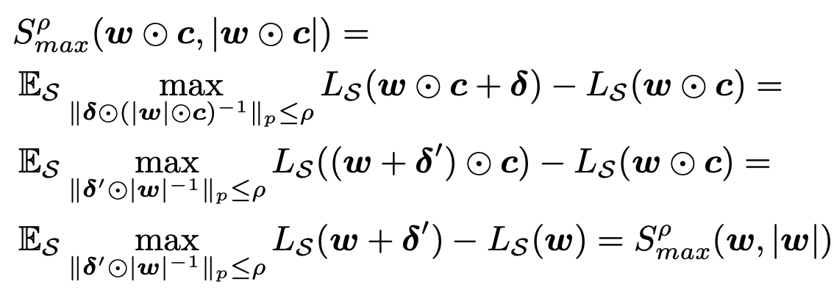
Backup slides
For any $c∈ℝ^{p}$ such that $f\left(w⊙c\right)=f\left(w\right)$, we have:

